Slide 1
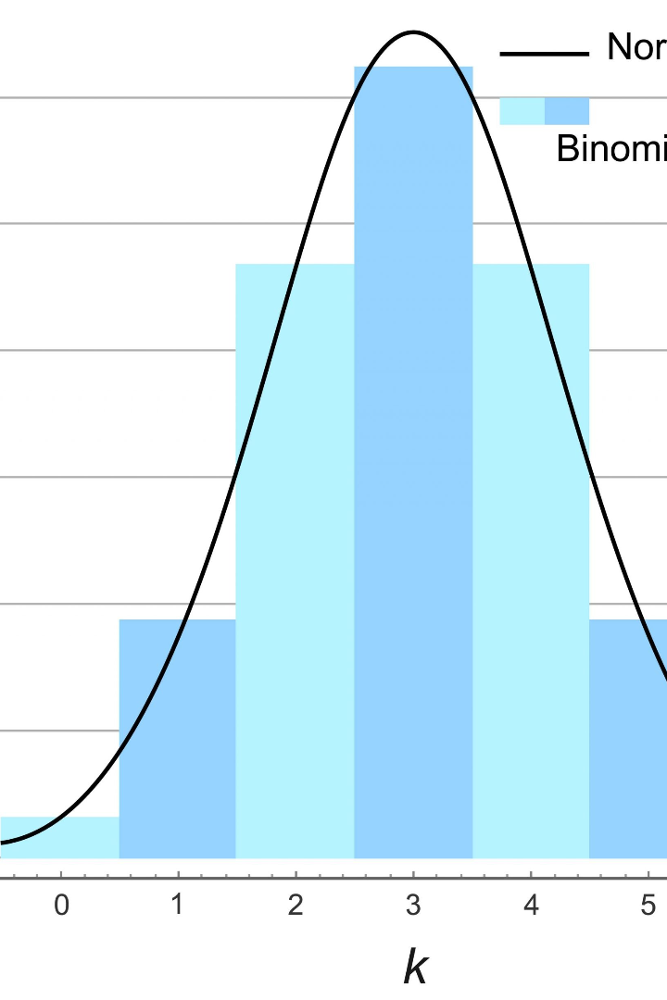


The Fascinating World of Probability Distributions
Probability distributions are a fundamental concept in statistics. In this presentation, we will delve into two important distributions: Poisson and Exponential. Join us in this informative journey!
by Pranavi Pulluri

Slide 2

Poisson Distribution: Definition and Properties
What is Poisson Distribution?
A discrete probability distribution that expresses the probability of a specified number of events occurring in a fixed interval of time or space.
Characteristics of Poisson Distribution
The average number of events must be constant for different intervals, and the individual events must be independent of each other.
Applications of Poisson Distribution
Used in various fields such as finance, insurance, biology, and physics to model random events like earthquake occurrences, customer arrivals, and radioactive decay.

Slide 3


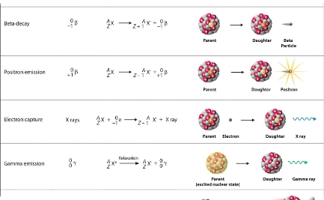
Visualizing Poisson Distribution with Examples
Lightning Strikes
Customer Arrivals
Radioactive Decay
Poisson distribution models natural phenomena such as the random occurrences of lightning strikes.
In business, Poisson distribution is used to study customer arrivals, allowing for accurate predictions for staffing and inventory requirements.
Radioactive materials decay spontaneously following Poisson distribution allowing accurate measurement of half-lives.

Slide 4

Exponential Distribution: Definition and Properties
1
What is Exponential Distribution?
Explains the time between events that follow a Poisson process.
2
Characteristics of Exponential Distribution
The probability density is the reciprocal of the mean, and the probability of one event occurring after a time t follows an exponential curve.
3
Applications of Exponential Distribution
Used in various fields such as reliability engineering, queuing theory, and finance, to model time between two successive events like time to failure of products and customers waiting in line.

Slide 5

Visualizing Exponential Distribution with Examples
1
Reliability Engineering
Exponential distribution is used to model the life expectancy of products to predict their longevity and improve their reliability.
2
Queuing Theory
In queueing theory, Exponential distribution is used to model the time between two successive arrivals in a queue, which helps determine how long customers have to wait in line before getting served.
3
Finance
When modeling stock prices, Exponential distribution is used to describe the time until the next rise or fall in prices.

Slide 6
Comparing Poisson and Exponential Distributions
Poisson Distribution
Exponential Distribution
Discrete data
Continuous data
Counts the number of occurrences
Captures the time between two events
Time is fixed
Time is not fixed

Slide 7
Key Takeaways: What We've Learned Today
Probability distributions are important in statistics and used in many fields
They help us understand and explain random occurrences in the world around us.
Poisson Distribution models the number of events
Poisson distribution applies to random events like customer arrivals, radioactive decay, and earthquake occurrences.
Exponential Distribution models the time between events
Exponential distribution applies to time between two successive arrivals in a queue, reliability engineering, and stock prices modeling.

Slide 8

Conclusion
We hope this presentation sparked your curiosity about probability distributions and provided valuable insights into Poisson and Exponential Distributions. Understanding probability distributions will undoubtedly provide a solid foundation for exploring more advanced statistical concepts.

